Slide 1
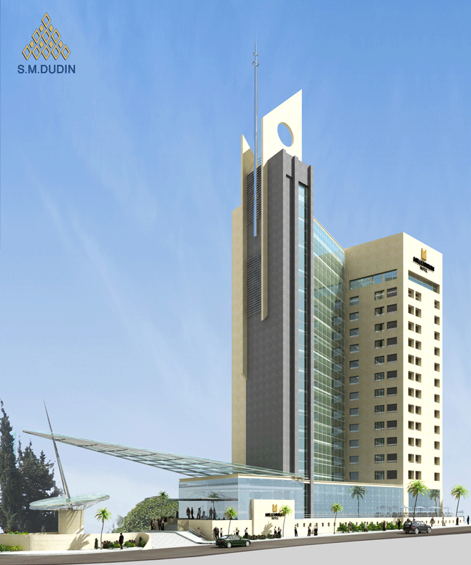

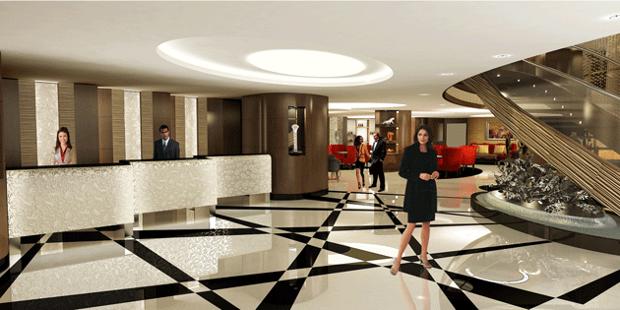
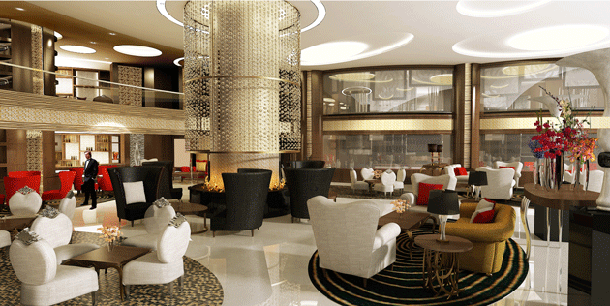
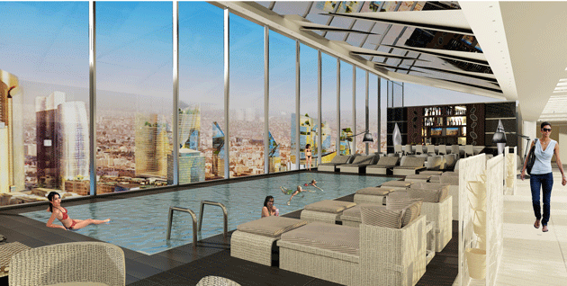
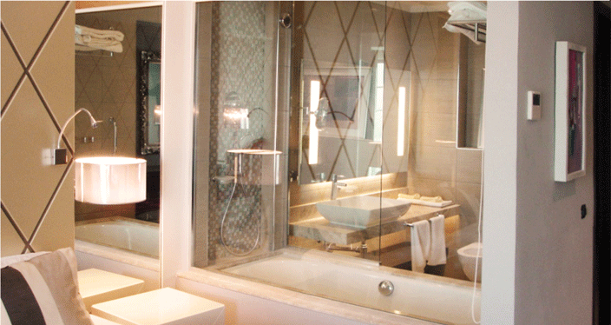
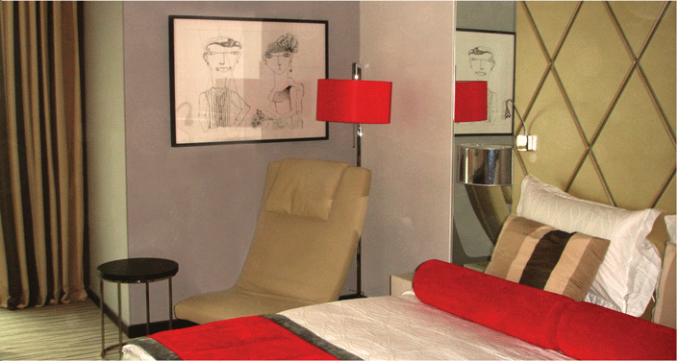

Slide 2
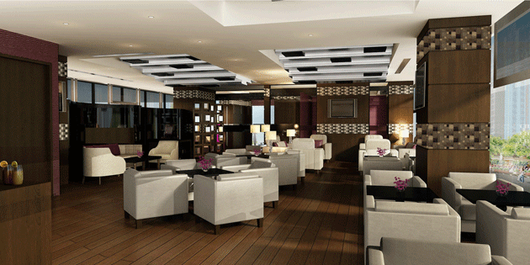
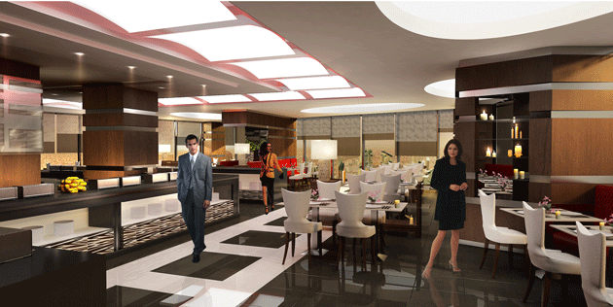
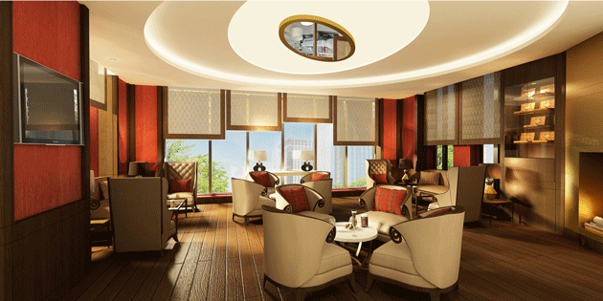
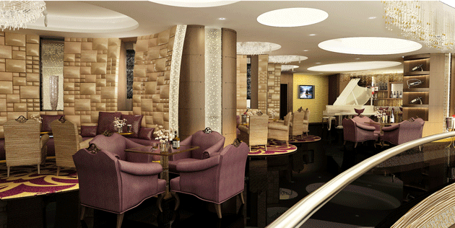
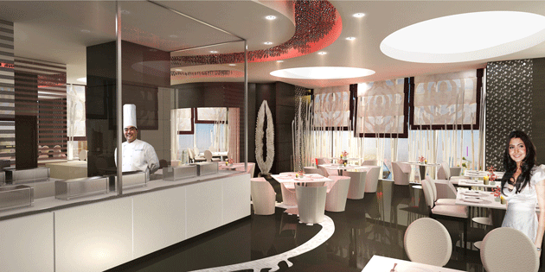


Introduction
M&C Hotels signed the management contract for the Millennium Hotel Amman in January 2010.
Now – almost 2 years later – we are looking at opening the hotel in the 2nd quarter of 2012.
Pre-opening office:
Eastern House - Sweifieh, P.O. Box 940389,
Amman 11194 - Jordan
Tel: +962 6 582 6393 Fax: +962 6 5825439
E-mail: menno.deboer@mill-cop.ae
Factsheet

Slide 3
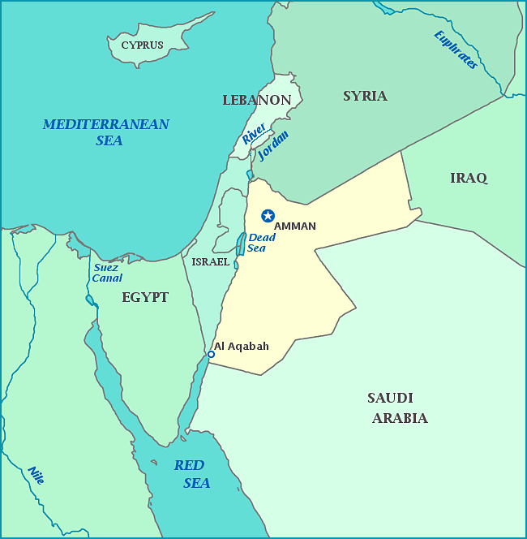
Jordan – Facts & Figures
Location: Nestled between Israel, Lebanon, Syria, Iraq and Saudi Arabia with the port of Aqaba providing sea access.
Ruled by the Hashemite royal family, Jordan’s political climate – although in turmoil on account of reform demands – is relatively stable
Predominantly a trading nation, Jordan possesses few natural resources other than Potash and phosphates.
Pre-opening office:
Eastern House - Sweifieh, P.O. Box 940389,
Amman 11194 - Jordan
Tel: +962 6 582 6393 Fax: +962 6 5825439
E-mail: menno.deboer@mill-cop.ae
Factsheet

Slide 4
Main industries: (Clothing, Mining, Fertilizers, Pharmaceuticals, Petroleum Refining, Cement, Inorganic Chemicals, Light Manufacturing and Tourism)
Jordan is technologically advanced, and leads in the fields of IT, medical care and education
Main cities in Jordan are Amman, Zarqa, Irbid, Ma’an and Aqaba.
Pre-opening office:
Eastern House - Sweifieh, P.O. Box 940389,
Amman 11194 - Jordan
Tel: +962 6 582 6393 Fax: +962 6 5825439
E-mail: menno.deboer@mill-cop.ae
Factsheet

Slide 5
Tourism:
Jordan boasts a number of historical sites dating back to the Byzantine era. A classical tour of Jordan usually includes two days in Amman with visits to Jerash, the Roman Theatre and downtown Amman. Other major tourist sites are the Dead Sea, Madaba and Mount Nebo, Karak, Petra and Wadi Rum.
Due to its advanced medical facilities, Medical tourism has increased over the past few years.
Pre-opening office:
Eastern House - Sweifieh, P.O. Box 940389,
Amman 11194 - Jordan
Tel: +962 6 582 6393 Fax: +962 6 5825439
E-mail: menno.deboer@mill-cop.ae

Slide 6
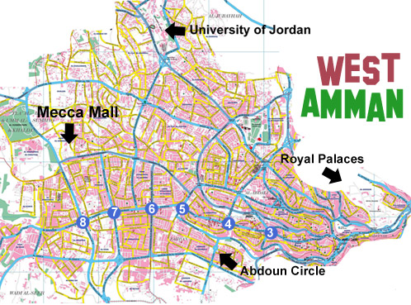
Millennium Amman
Pre-opening office:
Eastern House - Sweifieh, P.O. Box 940389,
Amman 11194 - Jordan
Tel: +962 6 582 6393 Fax: +962 6 5825439
E-mail: menno.deboer@mill-cop.ae
To Airport

Slide 7
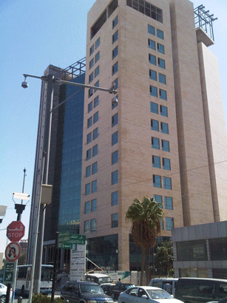
Millennium Hotel Amman:
Floors: 20 stories (4 basement carpark)
Rooms: 178 rooms and suites; Club floors with lounge
Outlets:
  All Day Dining restaurant
  Toshi: Asian restaurant
  Mezzanine Bar
  Cigar Bar
  Sky Bar
  Meeting and Conference facilities
  24hr room service
Pre-opening office:
Eastern House - Sweifieh, P.O. Box 940389,
Amman 11194 - Jordan
Tel: +962 6 582 6393 Fax: +962 6 5825439
E-mail: menno.deboer@mill-cop.ae

Slide 8
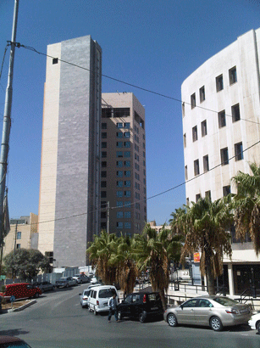
Amenities & Services:
Room Management System (RMS)
Docomo Interactive TV entertainment system
40’’ and 42’’ TV sets
Digital Signage in public areas
WiFi and Wired internet access
Seven fully equipped conference & banqueting rooms
Top floor indoor swimming pool with breathtaking views
Health Center with mini-gym and massage treatment rooms, Gift shop, ATM
CCTV, and high-end security
Valet parking – 180 slots
Pre-opening office:
Eastern House - Sweifieh, P.O. Box 940389,
Amman 11194 - Jordan
Tel: +962 6 582 6393 Fax: +962 6 5825439
E-mail: menno.deboer@mill-cop.ae

Slide 9
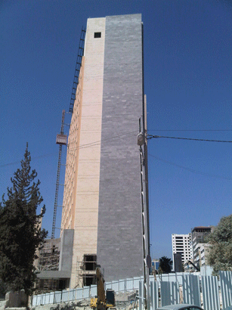
Main competitors:
Kempinski Amman:
  Same location; opened in 2005, demotivated team
  Le Meridien Amman
  Tired, old hotel, which is rumored to change ownership. Large meeting facilities
Amman Marriott:
  Solid reputation, location not central
Crown Plaza Amman:
  Polular hotel, building is overshadowed and inconvenienced by construction of the Amman towers
Le Royal Amman:
  Landmark building, serves mainly Iraqi clientele
Pre-opening office:
Eastern House - Sweifieh, P.O. Box 940389,
Amman 11194 - Jordan
Tel: +962 6 582 6393 Fax: +962 6 5825439
E-mail: menno.deboer@mill-cop.ae

Slide 10
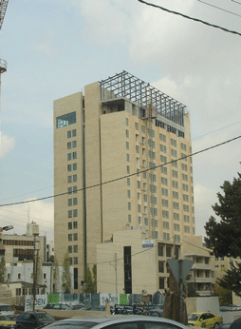
Sales Focus
Owning company related
Corporate (Banking, Commerce, Hospitals and Pharmaceutical)
Government
Leisure (Spanish, French, German markets)
Online booking channels
Pre-opening office:
Eastern House - Sweifieh, P.O. Box 940389,
Amman 11194 - Jordan
Tel: +962 6 582 6393 Fax: +962 6 5825439
E-mail: menno.deboer@mill-cop.ae

Slide 11
Reception

Slide 12
Hotel Lobby

Slide 13
All Day Dining

Slide 14
Mezzanine Bar

Slide 15
Cigar Bar

Slide 16
Toshi Asian Restaurant

Slide 17
Executive Floor Lounge

Slide 18
Sky Bar

